Slide 1


Team 18: Photometer
Final Bi-Weekly Update
Rigoberto Olivares, Hunter Cothran, Richard Lopez
Sponsor: Max Lesser TA: Rohith Ramanujam Kumar

Slide 2
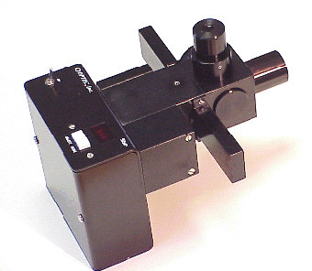
Project Summary
Our customer Don, an astronomer at A&M, desires a modern re-envisioning of an OPTEC photometer, which were designed in the 70s
Astronomers often make their own photometers to measure light of stars, eclipses, etc, with photodiodes in conjunction with simple circuit components, despite ranges of possible voltages, a universal unit can be derived
A drawback of OPTEC’s original design – photomultiplier tubes (high voltage) and the need to filter light
Notes:
Kyle

Slide 3
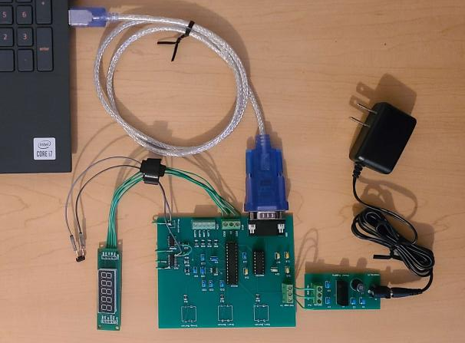
Integrated Project Diagram
Software Interface
Photodiode
Power Supply
{
Display
User Input

Slide 4
Engineering Design Accomplishments - Hunter
Designed, tested, validated ABS plastic enclosure for photometer, photodiode securement conditions, telescope M42 attachment/weight conditions, creating holes for user interface and device interfaces with minimal light pollution
Challenge of binding plastic/aluminum, solution found in JB Weld plastic bonding/epoxy plus super glue
Tested various loads 250g-500g with different distribution patterns
Holes dremeled for buttons
Task left, final integration step, dremel slots for power/DB9/display and secure PCB in enclosure

Slide 5
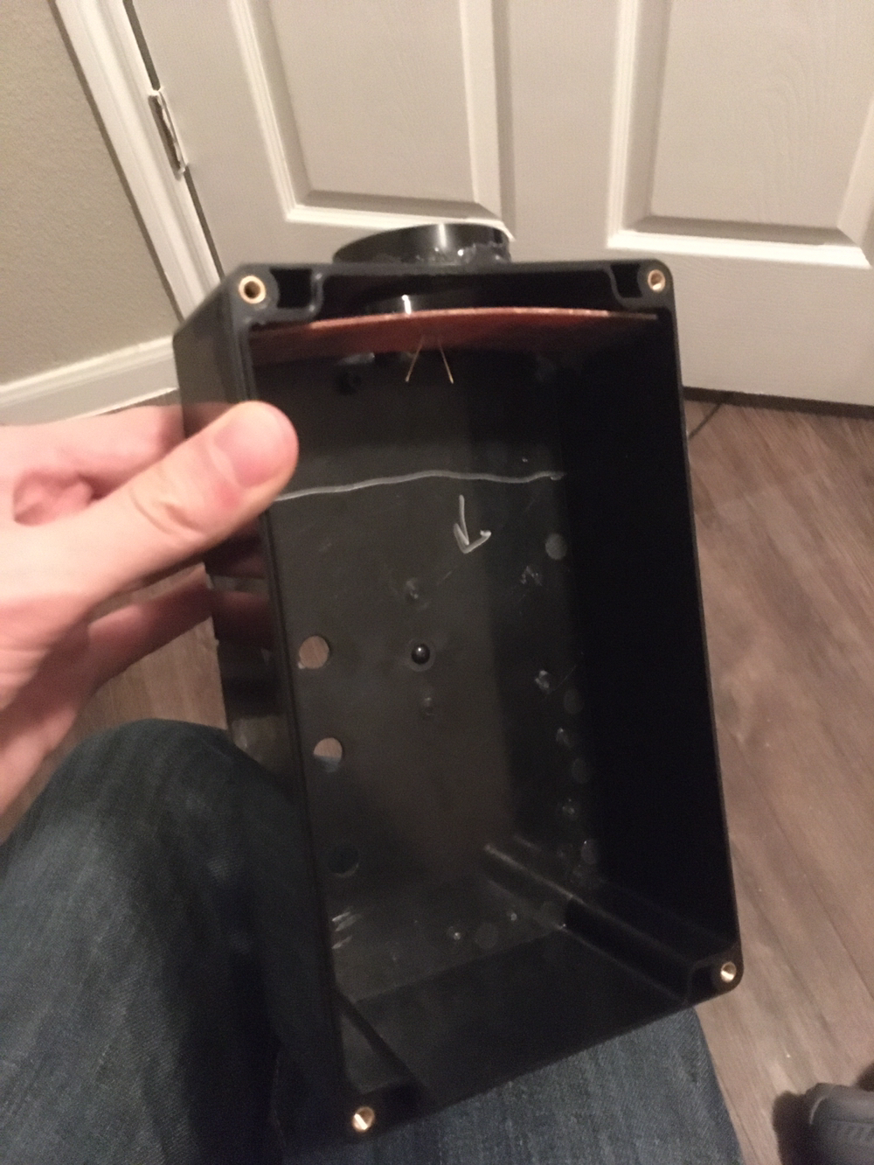
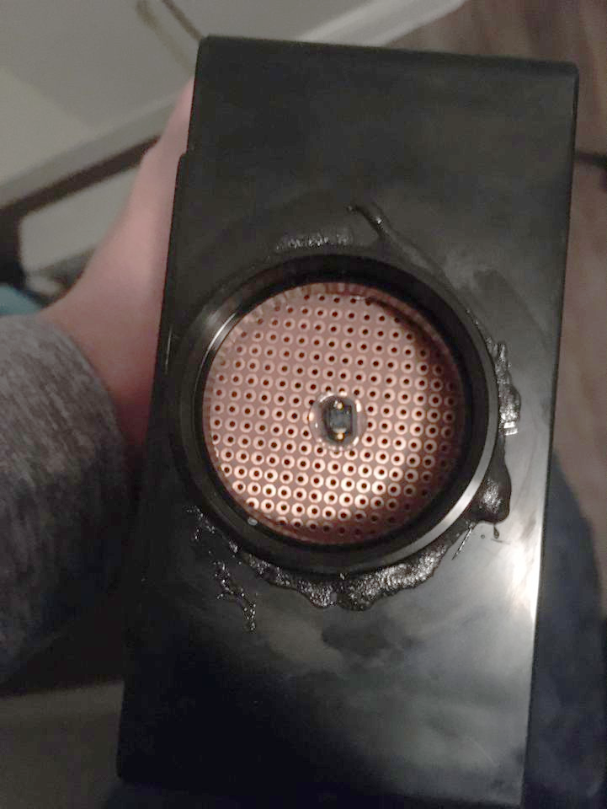

Slide 6
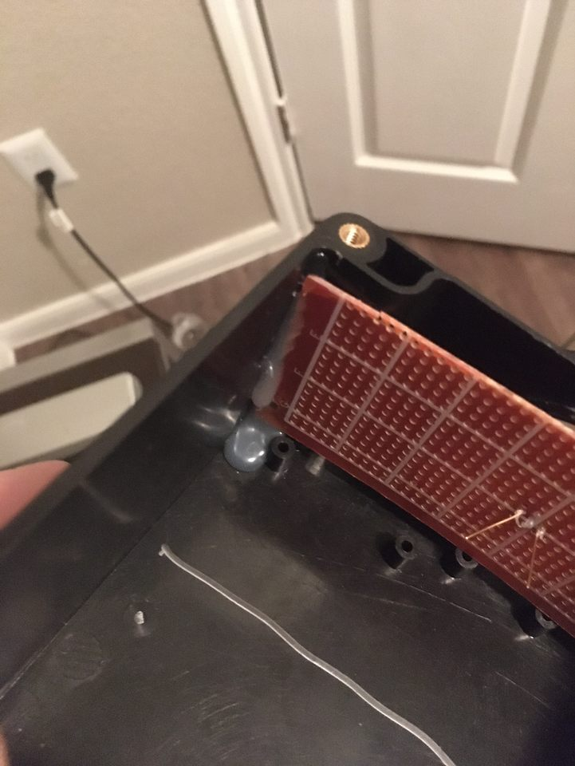
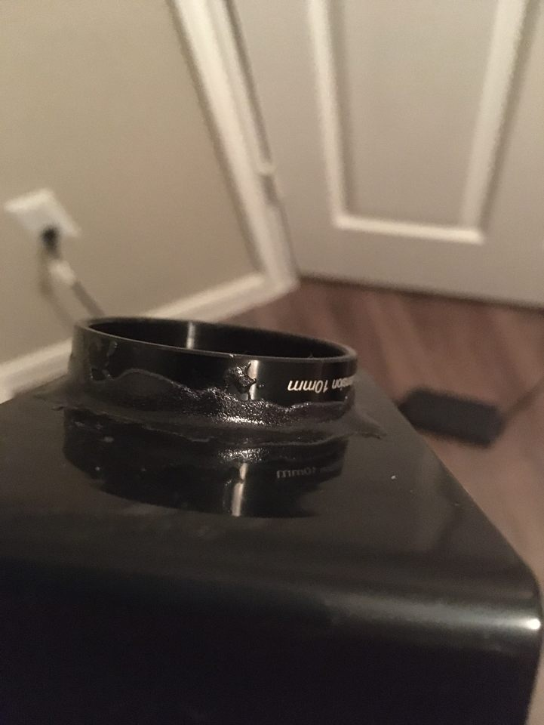

Slide 7
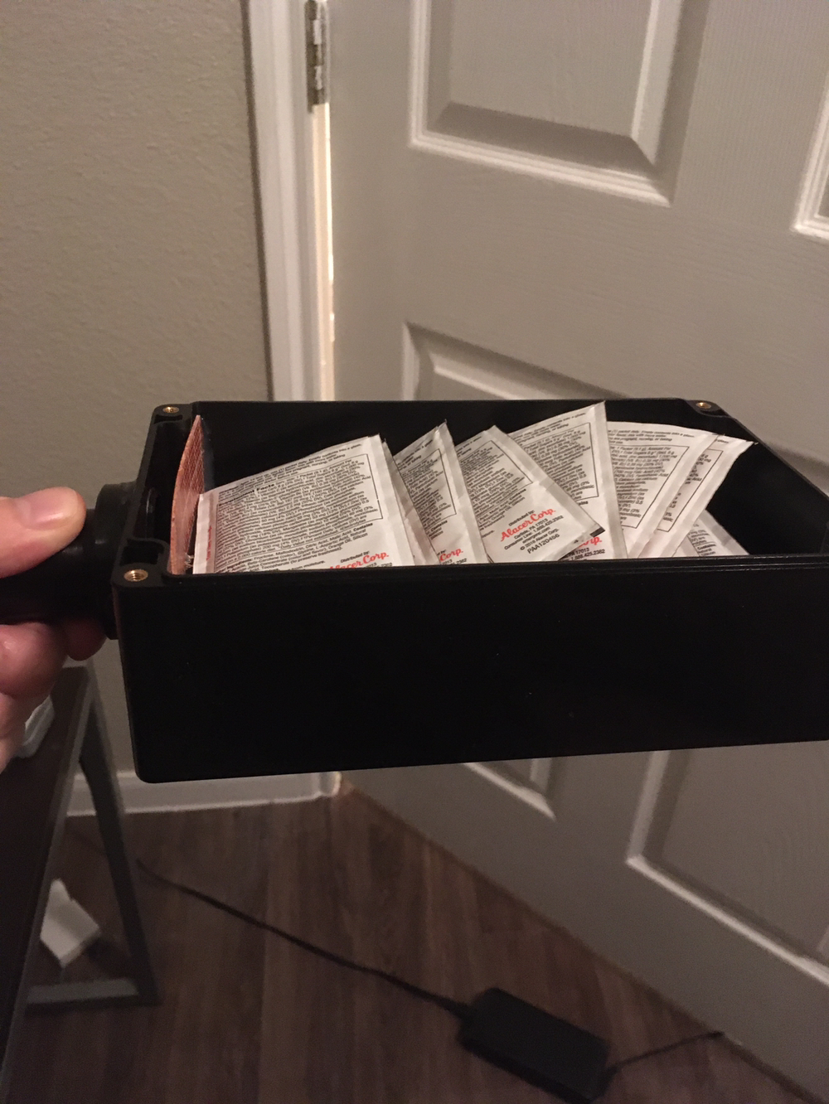
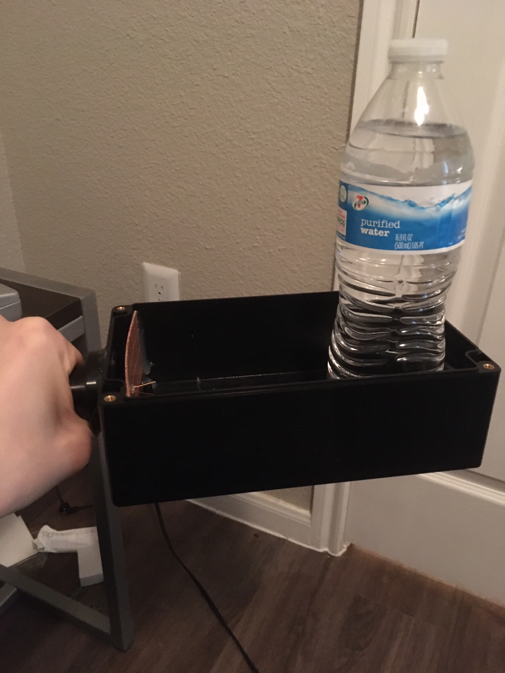

Slide 8
Engineering Design Accomplishments
Accomplishments:
Implemented a protocol to transfer data from the Photometer.
Created a power supply to power the photometer.
Designed a PCB.
Challenges:
Learning to work program a PIC microcontroller.
Learning information transfer protocols such as SPI and UART.

Slide 9
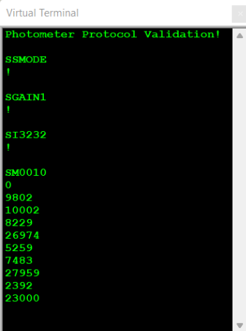
Photometer Protocol
A total of five commands were implemented:
SSMODE
SGAINn
SInnnn
SCOUNT
SMnnnn
SENDxx

Slide 10
Engineering Design Accomplishments
Accomplishments
Designed PCB and soldered
Setup the ADC
Setup 7 segment gain and integration
Challenges:
Switched to SPI
PCB traces broke off
Leg of mux broke off

Slide 11
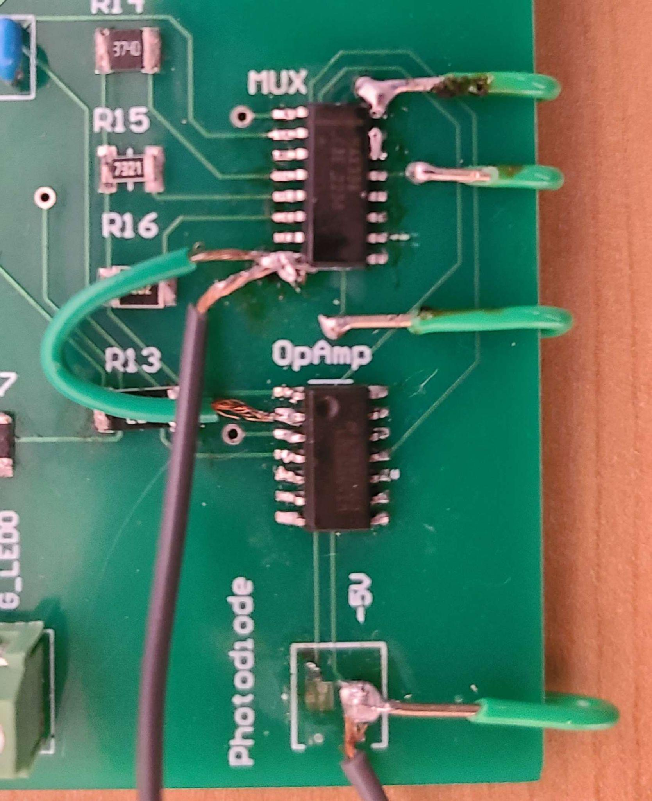
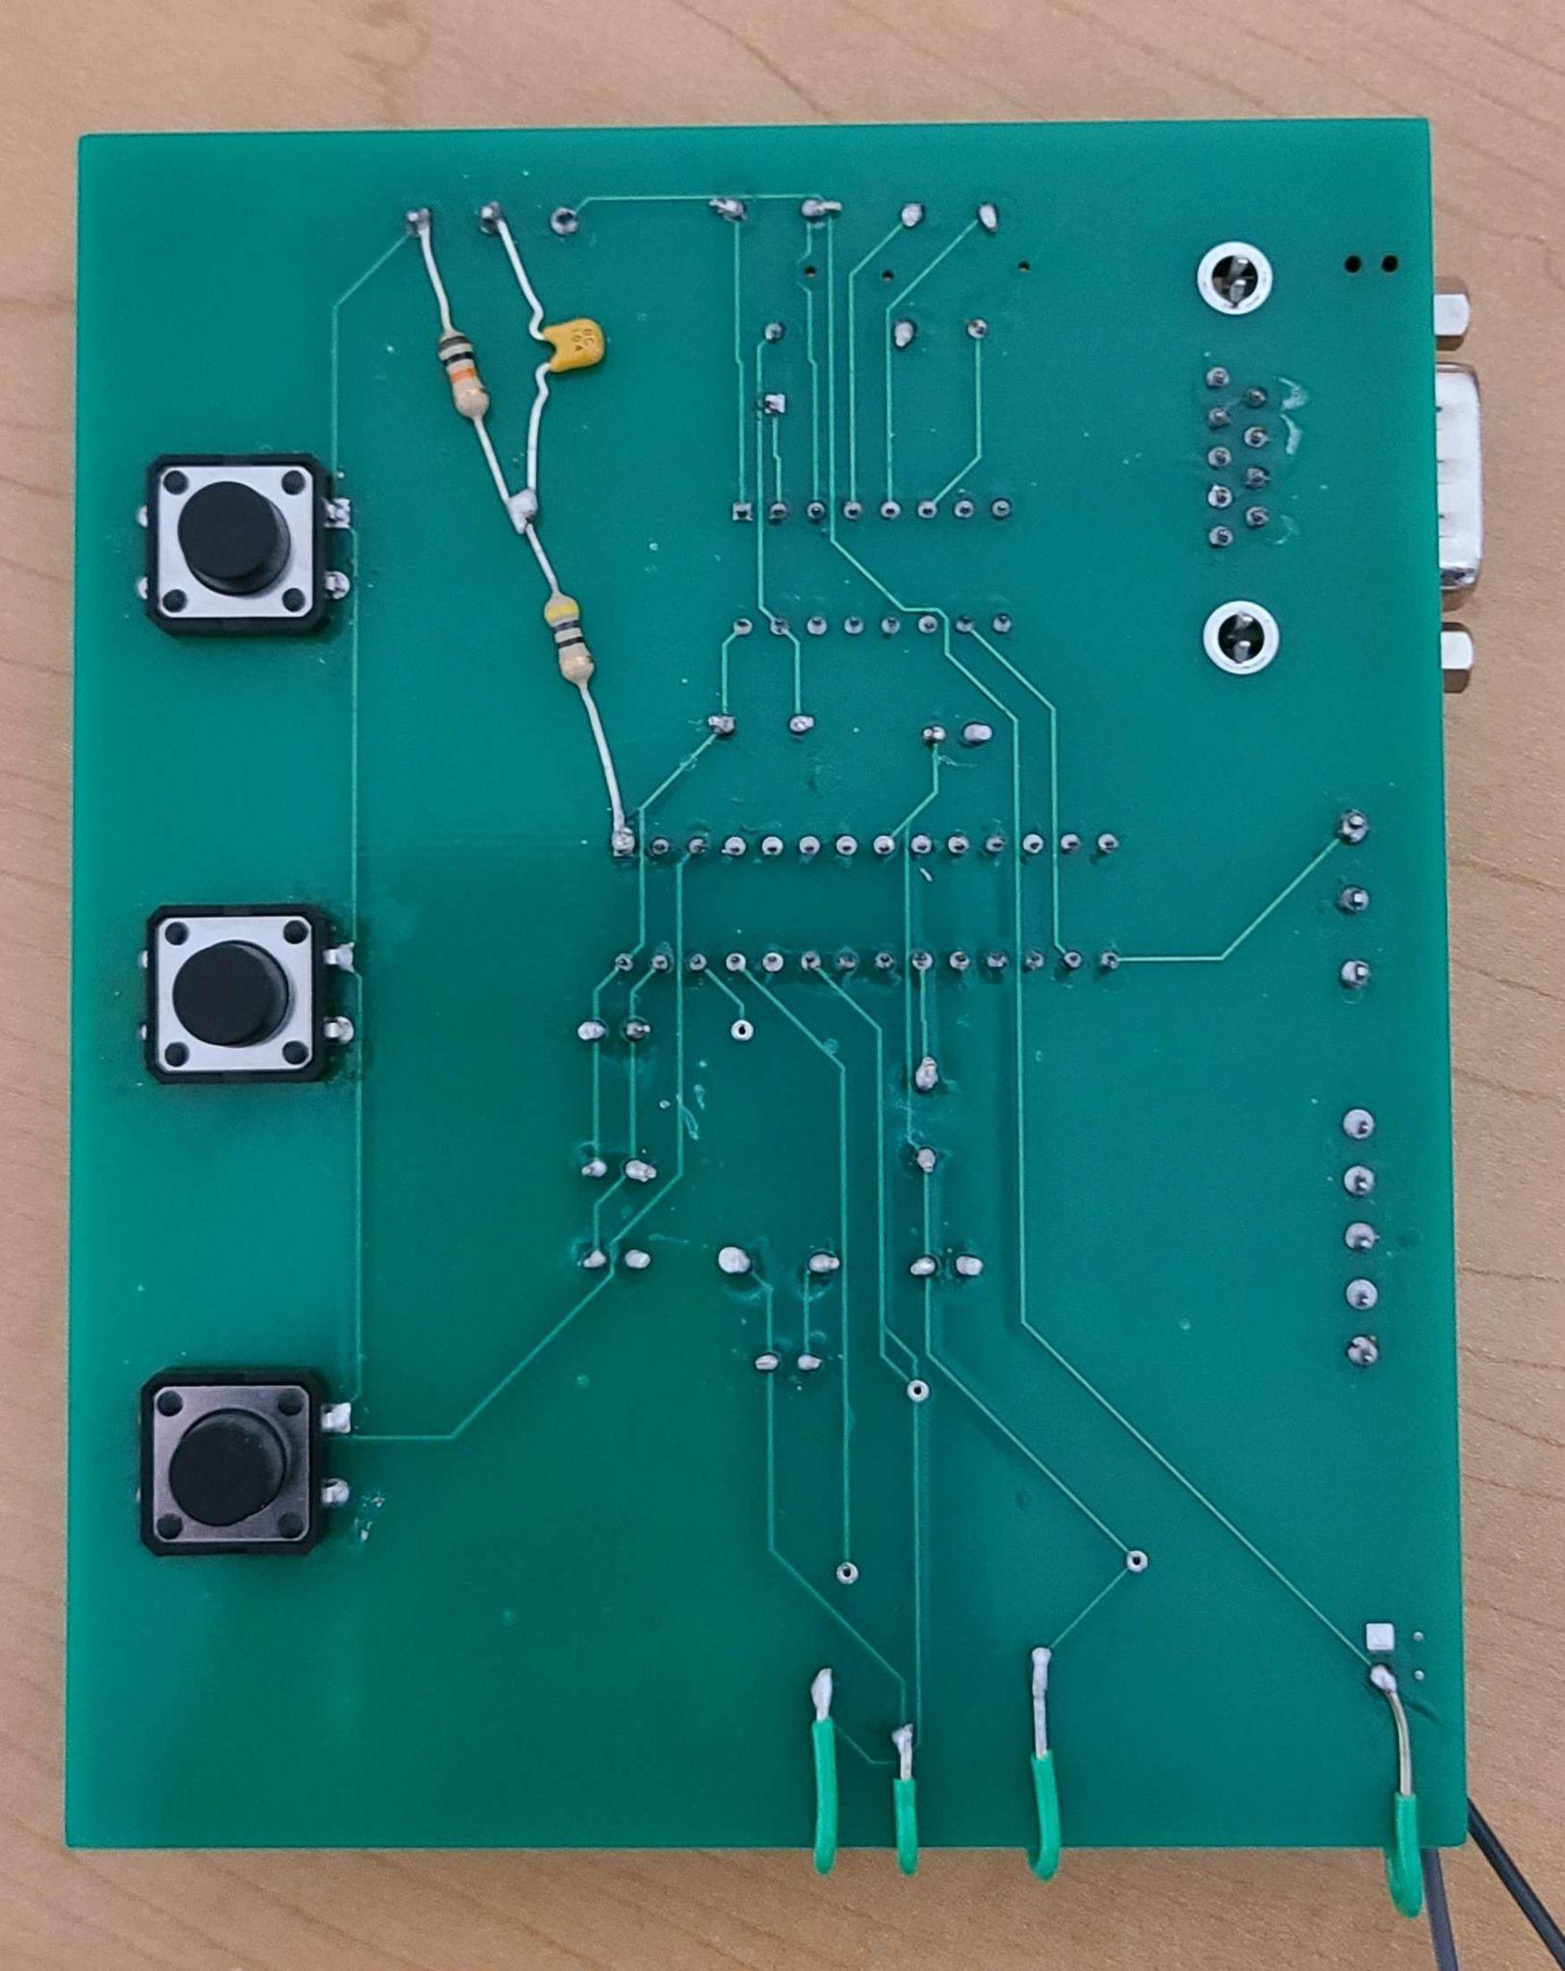

Slide 12
Integrated System Results
Project Accomplishments:
Reduced operation voltage to a level that is safe for the user of the photometer.
Photometer is able to read different voltage values at different levels of light intensity.
Overall device has a similar look to the original OPTEC design.

Slide 13
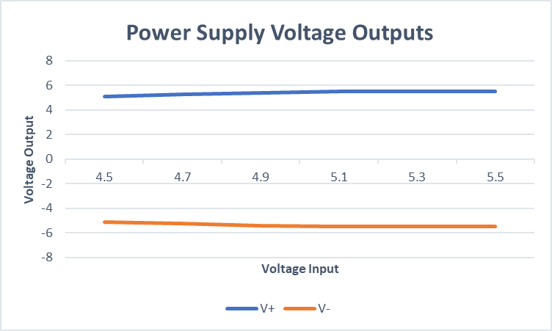
Operation Voltage
Original Photometer design made us of dangerously high voltage levels.
We have reduced the operation voltage to a safe level while keeping the photometer functionality.

Slide 14

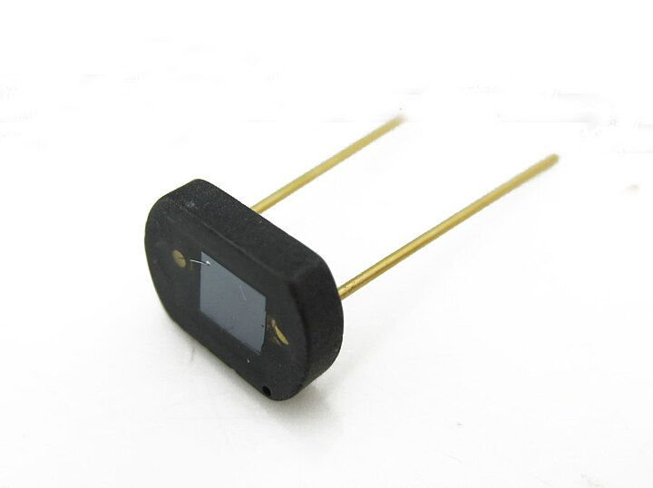
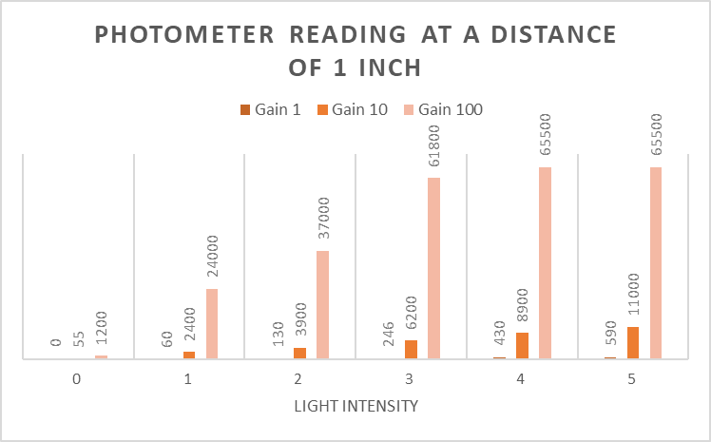
Photometer Operation
1 in.

Slide 15
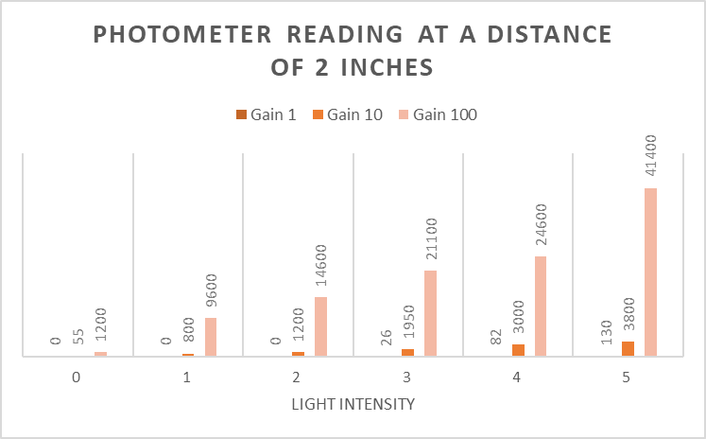
Photometer Operation
2 in.

Slide 16
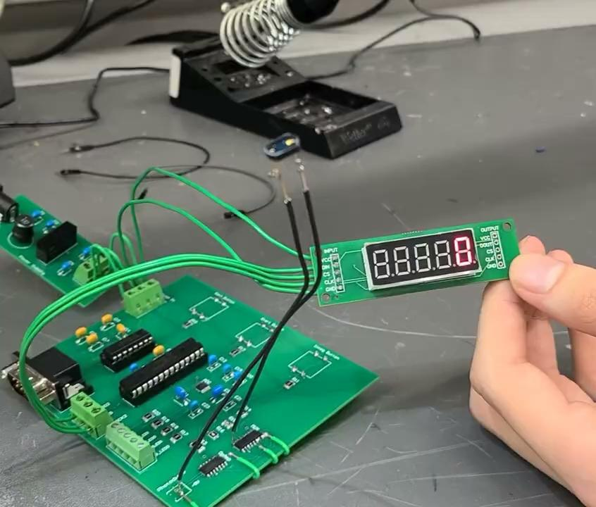
Demo Video
https://drive.google.com/file/d/1Y2aZ4y3SZYTcbL6GOiZB_Sv2UaeheM2r/view?usp=share_link

Slide 17
Conclusions
Changes
Multiplexing to SPI
Code Integrations
Integrate PCB into Finalized Enclosure
Current status:
Resistor value need to be resoldered
PCB backup being made
Take measurements at Don’s telescope and compare to Optec values (variation expected)

